Slide 1

TaskScore: Blick unter die Oberfläche
U-Boot – Meeting 18.01.2022
Frank Langner

Slide 2

Outline
Useful stuff
High level stuff
Source code stuff
Build the stuff

Slide 3
Useful stuff
Development environment VM
„Ready to go“ Rust development VM (VirtualBox) downloadable here:
https://mysterymill.net/exchange/ausy_rust_vm.ova
Please ensure that you have about 40GB of available disk space
Source code repository: https://git.ausy-technologies.de/langnefr/taskscore
Clone URLs:
  SSH: git@git.ausy-technologies.de:langnefr/taskscore.git
  HTTPS: https://git.ausy-technologies.de/langnefr/taskscore.git
Learning:
  Rust introduction: /home/user/Rust Brown Bag/Introduction to the Rust programming language V_1_1.odp
  The Rust Book: https://doc.rust-lang.org/book/
  Rocket Docs: https://rocket.rs/v0.5-rc/guide/

Slide 4

High level stuff
Architecture
  Self-contained
  No DB connection (so far)
JSON
Rocket (web framework)
REST interface
Model
Repository

Slide 5
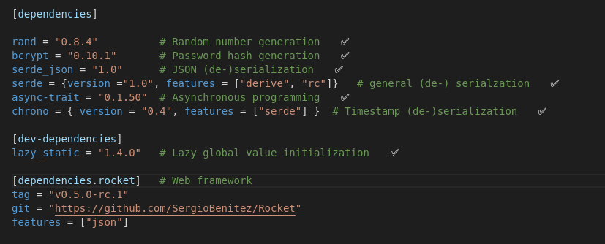
High level stuff
Libraries
Excerpt from Cargo.toml:

Slide 6
Source code stuff
Web interface
Rust is hard – but Rocket isn’t
Storage in Repository
Data race free data managemenmt is annoying
Structs and traits
… and operator overloading
Unit testing
… works

Slide 7
Build the stuff
Run unit tests only
Build and run locally…
  In debug mode
  In release mode
Cross compilation for easy deployment
$ cargo test
$ cargo run
$ cargo run --release
$ cross build --target x86_64-unknown-linux-gnu

